Slide 1

Search and Discovery
The Data Cookbook offers the user multiple search boxes. In this session, learn how each search box is indexed and how it uses relevancy to generate the display order for search results.
Workshop Wednesday Series #10
June 12 2019

Slide 2
Logistics
1st half of session is presentation and will be recorded
2nd half of session is discussion and will not be recorded
You will receive the link to the recording tomorrow
If question or comment put in the chat / question box

Slide 3


Brenda Reeb
  IData, Data Management Consultant
  breeb@idatainc.com
Jim Walery
  IData, Director of Marketing
  jwalery@idatainc.com

Slide 4
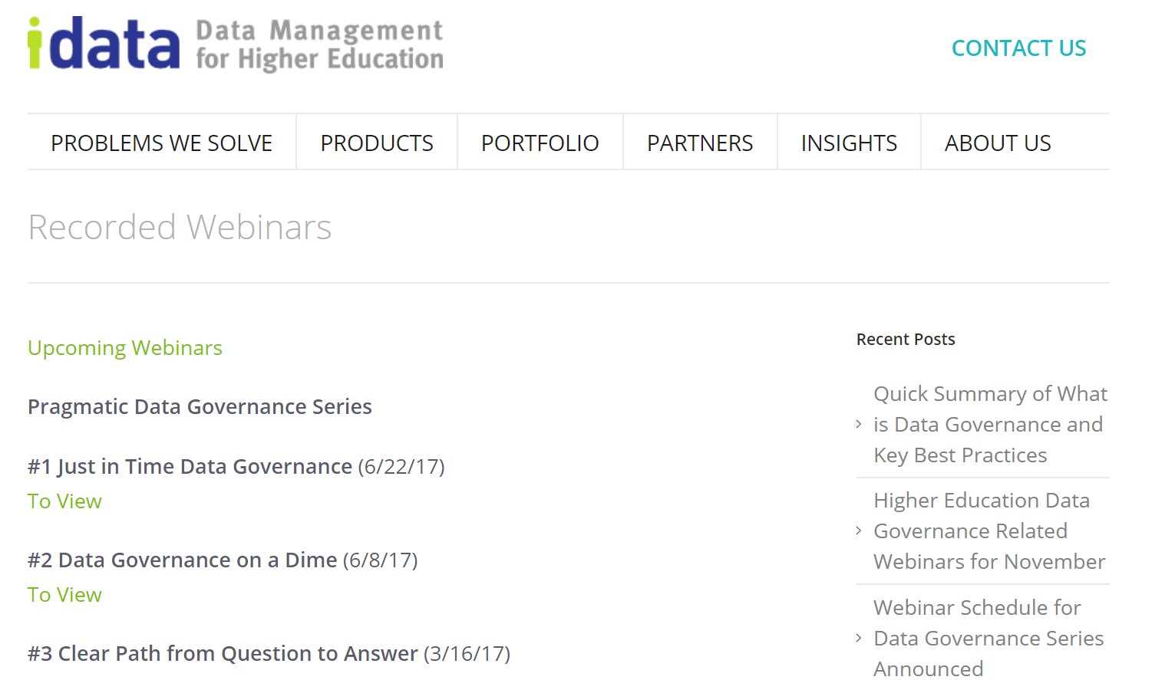
Recorded Data Governance Webinars
http://www.idatainc.com/recorded-webinars/
Upcoming webinars at: http://www.idatainc.com/about-us/idata-webinars/

Slide 5
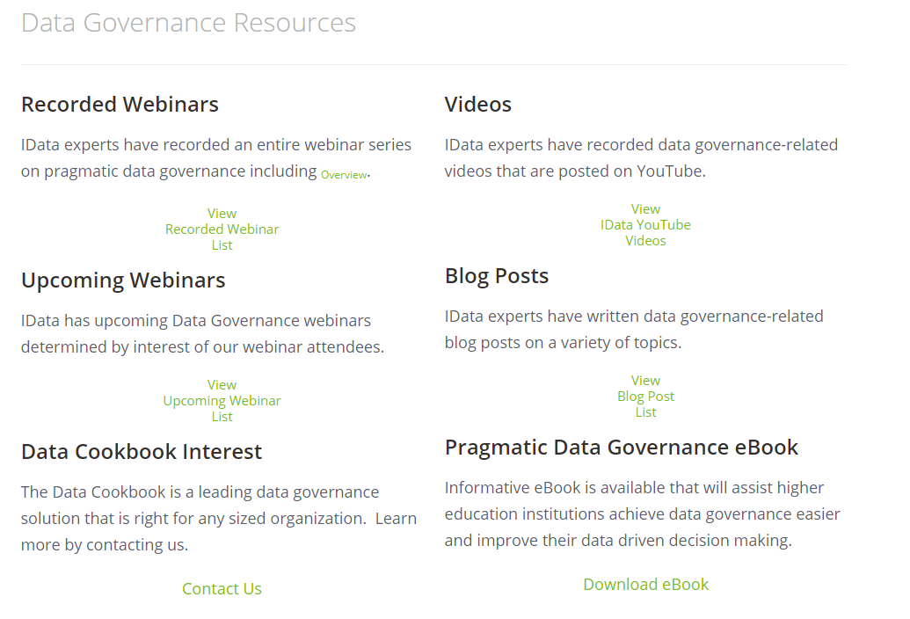
Data Governance Resources Page
http://go.idatainc.com/dg-resources

Slide 6









Be Part of the Community
community.datacookbook.com
Open to everyone
Content from regulatory agencies and other institutions.
Data definitions, Specifications, Contact information, Documentation
Watch for your community forum news emails

Slide 7
Agenda
Documentation
  Get the User Guide Appendix A!
4 Places to Search
Search Logs
Tricky stuff
Questions?
Notes:
Purpose of the session is to give a detailed overview of customized workflows.
Customized workflows were delivered in Summer 2017. They allow you to customized the workflow to match your governance structure. Before this, everyone had one workflow.
This will be Feature heavy, in the weeds.
It will be recorded.

Slide 8
Documentation
User Guide – p. 40
User Guide Appendix 13.6A Where Does the Data Cookbook Find My Search Terms?
Nothing in Admin Guide

Slide 9
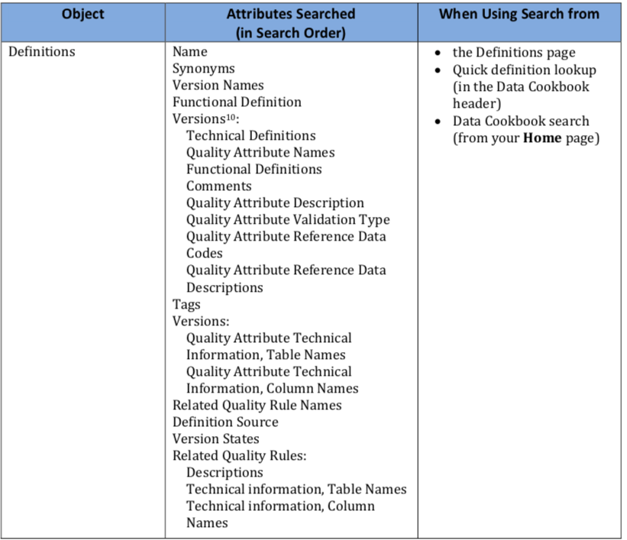
User Guide
Appendix A

Slide 10
4 Places to Search
Home Tab – Search the Data Cookbook
Find Data page
Quick Definition Look Up…
Browse Search by object

Slide 11
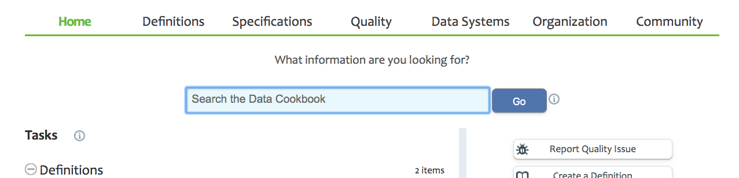
Location: Home Tab
Name: Search the Data Cookbook
Indexes: all Approved Definitions, Specifications, Data Systems (EE only)

Slide 12
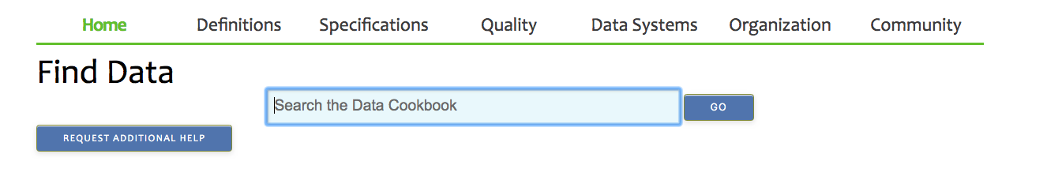
Location: Home Tab < Find Data page
Name: Search the Data Cookbook
Indexes: all Approved Definitions, Specifications, Data Systems (EE only)

Slide 13
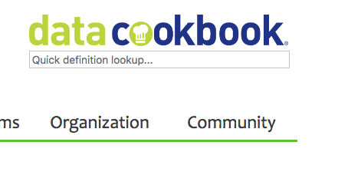
Location: Upper right corner, all pages
Name: Quick definition lookup…
Indexes: all local and community definitions; can toggle off community

Slide 14
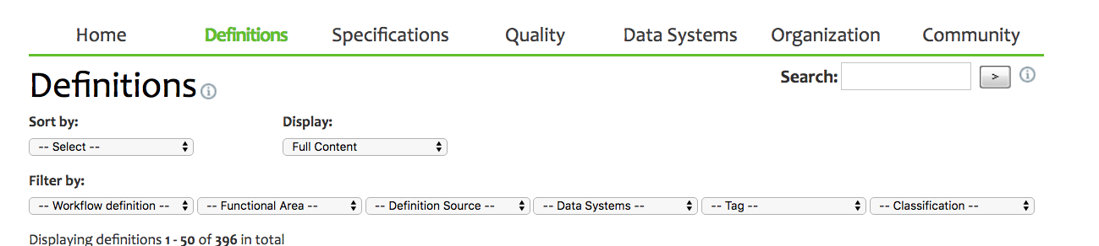
Location: Right side, below nav bar, all Browse pages
Name: Search:
Indexes: all local objects

Slide 15
4 Places to Search
Home Tab – Search the Data Cookbook
  Sample Applicant Aid or Athlete
Find Data page
  Sample Applicant Aid or Athlete
Quick Definition Look Up…
  Sample Applicant Aid
Browse Search by object
  Sample Applicant Aid

Slide 16
Search Logs
Check your own – mine are boring!
Rolling 30 days
  Spec Log does not include Collection
  Quality Log does not include Reference Data Lists
Why:
  User behavior
  Create content in response

Slide 17
Tricky stuff – not explicit in the Appendix
Reciprocity between Specifications and Collections
  Set up live: Collection Financial Aid Core Reports, enter zebra in Description
  Return to Spec Browse search and enter “zebra”
Must be Approved for Help page and Find Data
Information Requests and Quality Issues not searchable; use ^F
Search might be different for API searches
Technical metadata is indexed
  gl_rollup.actual_amt in Quick def lookup and Def Browse
Look for search terms in previous versions
  Version def Actual Amount and delete the tech def; then repeat the search for gl_rollup.actual_amt

Slide 18
More tricky stuff
Tags are searchable! They are so powerful
  Kpi, under Definition Browse and in Help tab.
Additional Attributes are not searchable
Reference Data list codes are searchable as a Quality Attribute
  Search “gold” in Quick definition lookup AND Browse Definition
  Search “gold” in Reference Data list Browse
Reference Data type is searchable in Quick definition lookup…
  Search “valid value” or “length”
There is a lot of indexing for Definitions in Find Data
  Search “kpi”, retrieve 1 Approved definition with kpi Tag
  Search ref value “wat”, retrieve Admit Type definition; also search “gold”

Slide 19
Summary
Check out Appendix A
Keep it simple when telling average users about Search
Home Tab and Find Data searches only retrieve Approved objects
Dig deep if you can’t see why a definition was retrieved

Slide 20
Get Help and Thank you!
  Pop Up Help within Data Cookbook (triangle in lower right corner)
  Ask clients – Post to Questions and Support in the Forum
  Ask IData Staff – support@datacookbook.com
  Visit http://support.datacookbook.com
  Visit Help link within Data Cookbook
    Administrators Guide (check for updates)
    User Guide (ditto)

Slide 21




Connect with Us
Follow us on LinkedIn for company and product information
www.linkedin.com/company/idata-incorporated
Follow Us on Twitter for to the minute information
@idatainc and @datacookbook
Subscribe to YouTube Channel for how to videos www.youtube.com/user/DataCookbook
Subscribe to our blog posts for educational information
www.idatainc.com/insights/

Slide 22

Let Us Know
Interested in any of the following:
  Providing a testimonial quote
  Being a Data Cookbook reference
  Having a case study done about your institution
  Writing a blog post
  Co-presenting at a conference or on a webinar
Send email to marketing@idatainc.com if interested

