Slide 1

Quality Rule Workflows
Managing quality rules is a key task in governance. The session covers roles, tasks, and process. We will review several Quality Rule Approval workflows to learn how the workflow can support your governance.
Note that Quality Rules are a feature in the Enterprise Edition. Knowledge clients will find this session useful for tips to manage quality rules externally to Data Cookbook.
Workshop Wednesday #12
December 4 2019

Slide 2
Logistics
1st half of session is presentation and will be recorded
2nd half of session is discussion and will not be recorded
You will receive the link to the recording tomorrow
If question or comment put in the chat / question box

Slide 3


Brenda Reeb
  IData, Data Management Consultant
  breeb@idatainc.com
Jim Walery
  IData, Director of Marketing
  jwalery@idatainc.com

Slide 4
Welcome
Say Hi in Chat – institution, what you want to learn about
Workshop Wednesdays on the horizon - 2PM EST
  January 22 Specifications Five Ways
  February 26 How to Import Content in Bulk

Slide 5
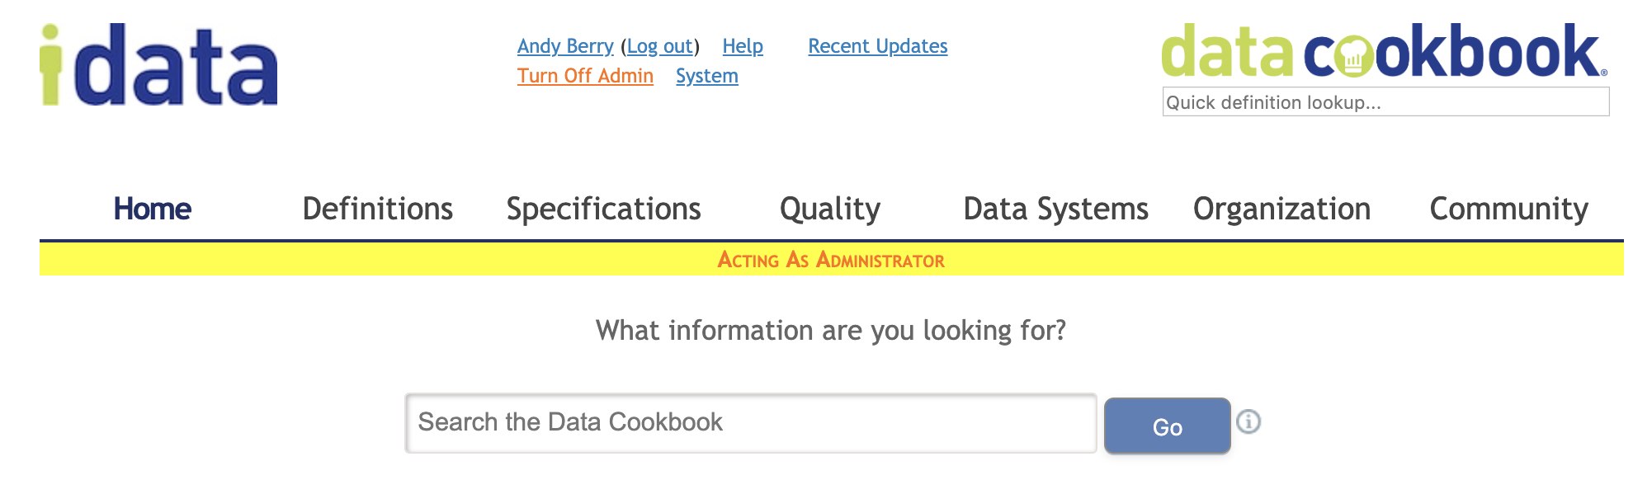
Data Cookbook Help Page

Slide 6
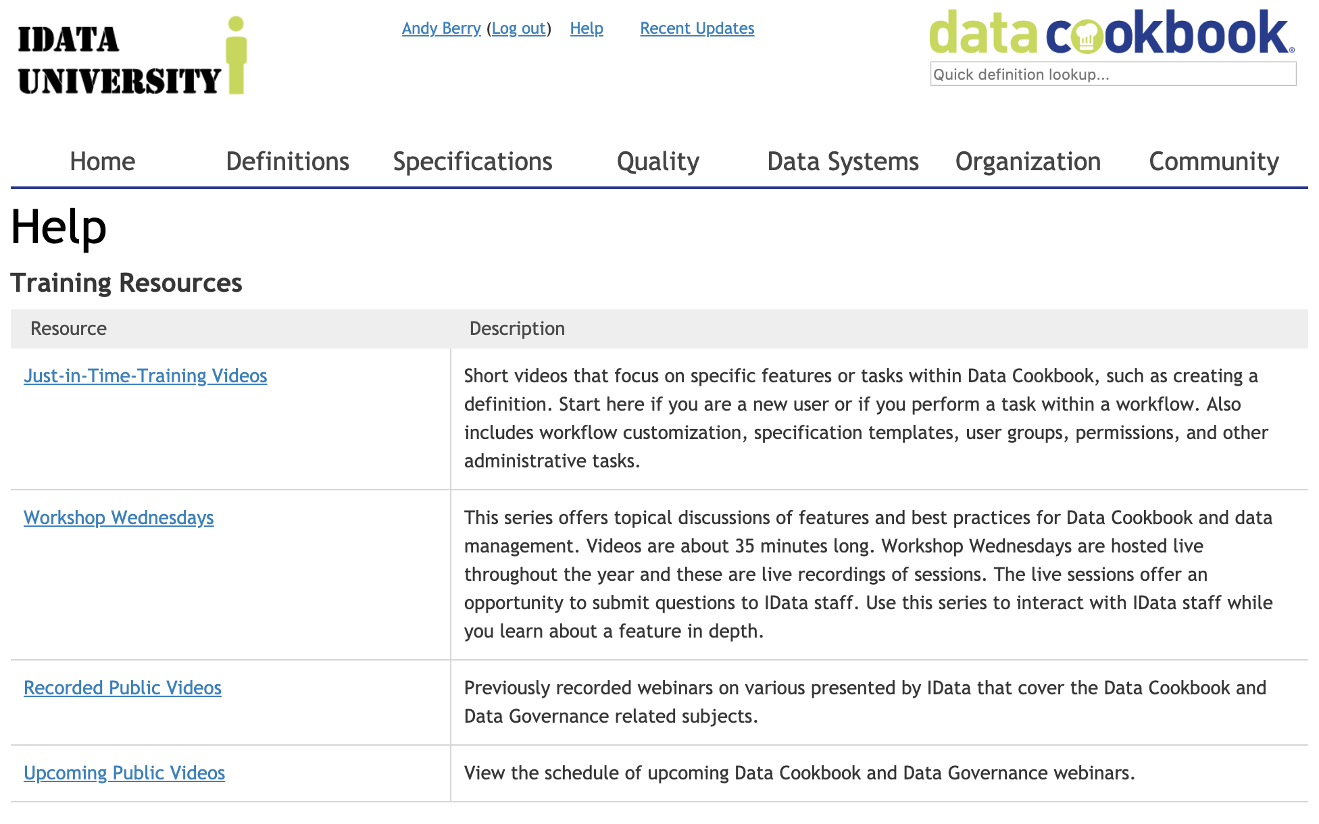
Training Resources

Slide 7
Agenda
Assumptions
Quality Rule basics
Examples of Quality Rule workflows
How does this relate to Knowledge licenses?

Slide 8
Assumptions
Login and type along in your Test or Prod account
Familiar with Workflow features
Knowledge or Enterprise licenses type
Schedule a consultation for more support
  support@datacookbook.com

Slide 9
Quality Rule basics
Technical rules
  Format | length | nulls |
Business rules
  Support a business process
It is valuable to WRITE IT DOWN where EVERYONE CAN SEE IT
A rule is an artifact around which to manage change
Who writes them? Data Steward or anyone…
Quality Rule is 1 milestone in Quality Management Process; today is not about quality issues.

Slide 10
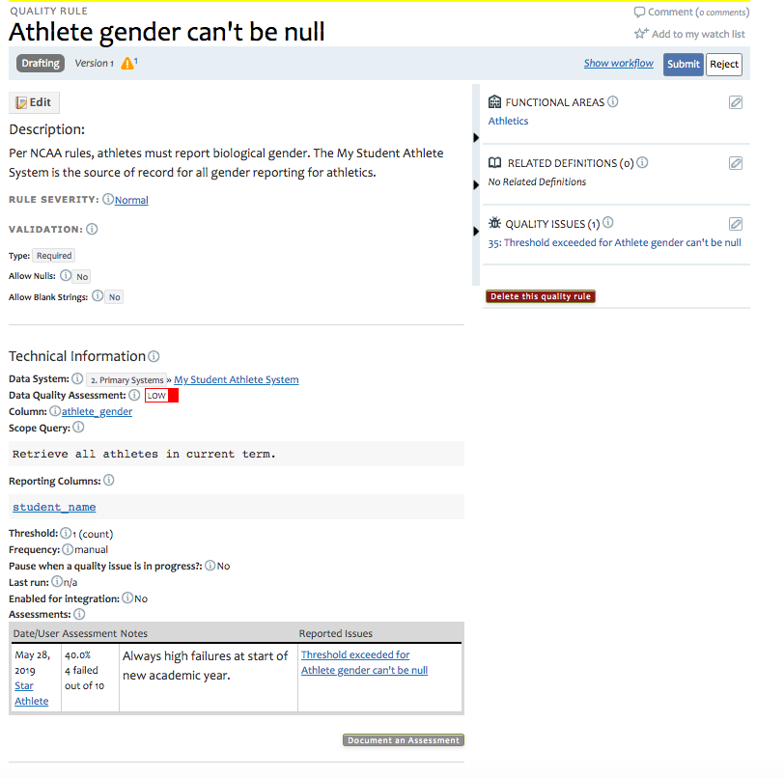

Slide 11
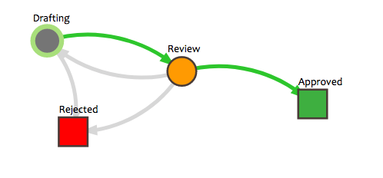
Default Workflow
Process | Draft | Review and Approve
Role name | Quality Rule Editor; Data Steward; other Editors | Data Steward Quality Manager
Job name | DBA, Assistant Registrar, Bursar, Parking attendant, | Registrar; Director; Bursar; VP
Notes | All points on the personnel hierarchy | Has authority; not line staff
Think about it (spell it out) but let’s not overthink it.

Slide 12
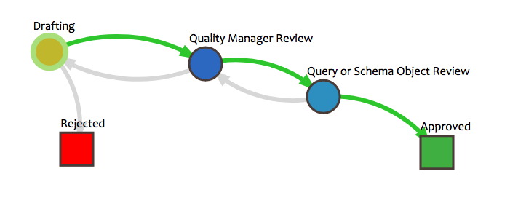
Most Popular Customized Workflow
Process | Draft | Review and Approve | Provide technical query or schema objects
Role name | Quality Rule Editor; Data Steward; other Editors | Data Steward Quality Manager | Technical Editor
Job name | DBA, Assistant Registrar, Bursar, Parking attendant, | Registrar; Director; Bursar; VP | DBA; Application Manager; report writer
Notes | All points on the personnel hierarchy | Has authority; not line staff | Technical skills of various stripes

Slide 13
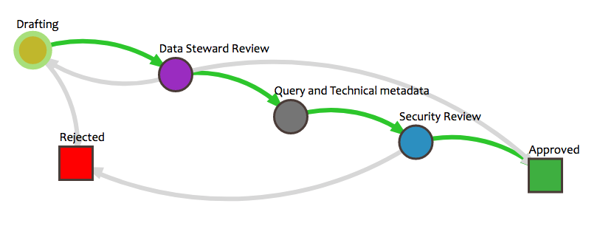
2nd Most Popular Workflow

Slide 14
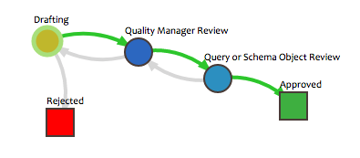
Review Demo Primary Quality Rule Approval
Summary: Anyone can start. Data stewards review. Submit to various technical people for technical metadata.
Scenario Easy – Dan creates a Rule
  Dan Helper submits rule Graduate Forwarding Address Cannot be older than 90 days (Advancement)
  Data steward Marci Money reviews it; relates definition student self-reported forwarding address; set the threshold to 3%
  Tech Nichols provides the schema objects and connects it to the Hub
  Enables rule to execute
Demo the rule first, then show the workflow admin

Slide 15
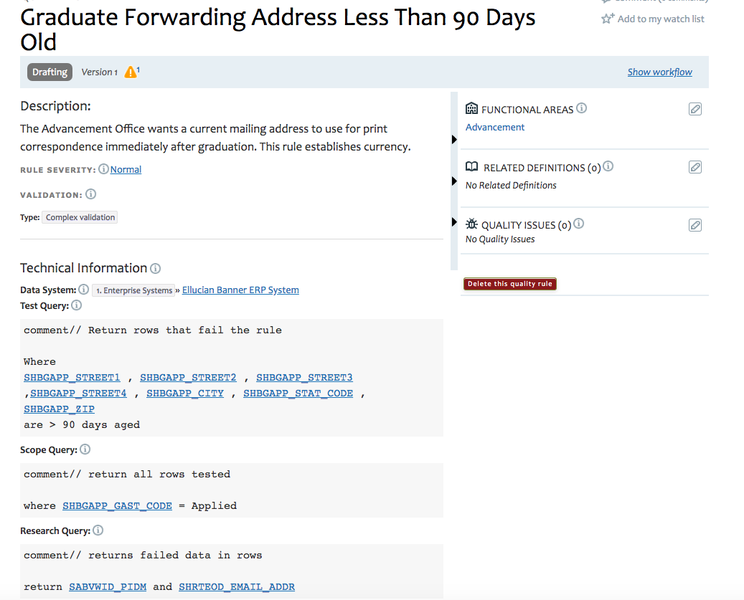
Dan Helper and Marci Money
Tech Nickles
Schema search “diploma mailing address”
AND SHBGAPP_ACTIVITY_DATE is > 90 days

Slide 16
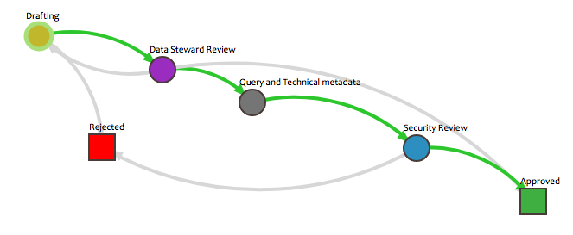
Review Security workflow
Dan Helper creates rule Employee phone number must include area code
Ginny Job Approves
HR Manager selects tech editor (named role)
George selects Lisa.
Ginny reviews again
Demo the rule first, then show the workflow admin

Slide 17
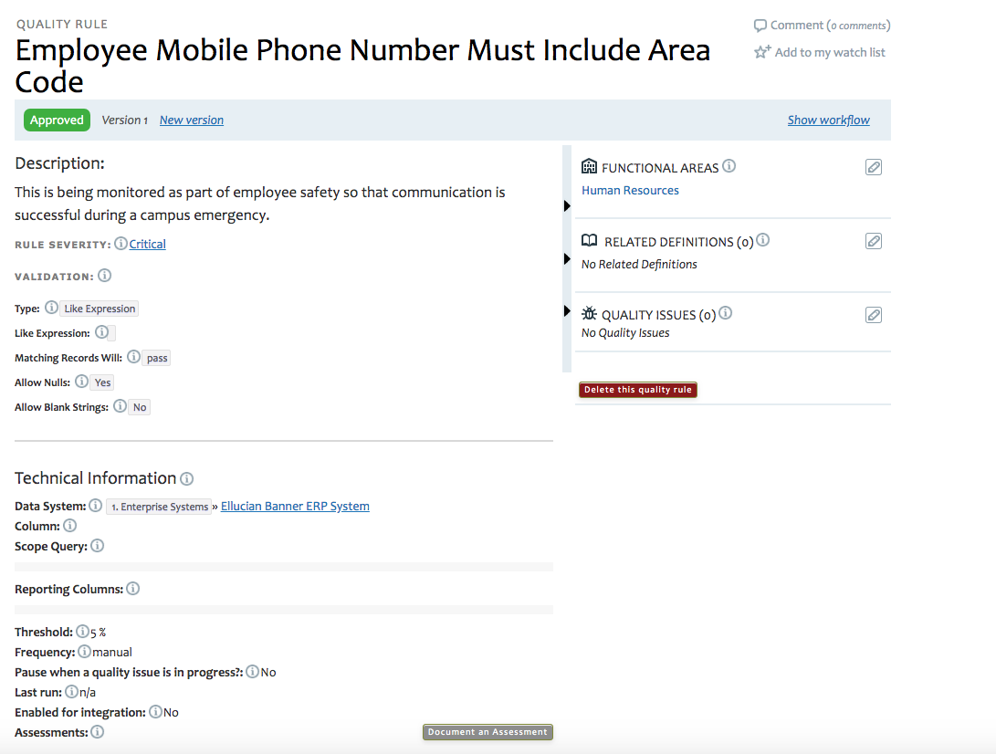
Dan Helper and Ginny Job
George Smith and Lisa Lang

Slide 18
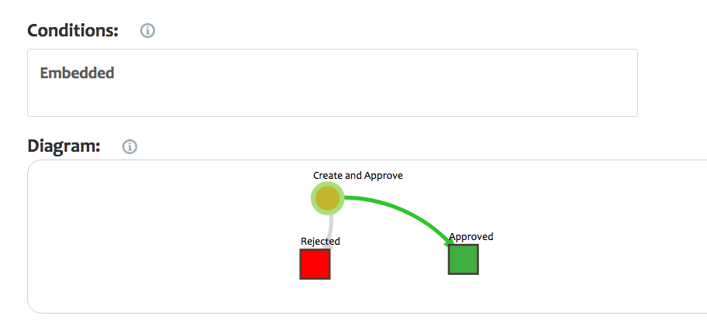
Quick Approval Embedded Rule
You need to build this; not default
Conditional = EMBEDDED
List on top of page of all quality rule workflows
Example: emergency phone number

Slide 19
Quality Program Process
Discover bad data
Write a rule
Measure against rule
Decide whether to fix bad data
Fix bad data
Quality Rule, Thresholds and IData Hub
Quality Issue workflow
Quality Issue workflow
Anywhere in your data universe…
Quality Rule
= green means use Data Cookbook or IData Hub

Slide 20
What about Knowledge?
Create an inventory catalog in Excel or other platform
Assign 1 person to become familiar with rules recorded within applications; ¼ or ½ FTE; provide training to people who record rules within applications
Host a meeting cycle to review rules, address problems. Create a face to face community around quality rules

Slide 21
Summary
Quality rules are 1 stop in the Quality Rule process
Write it down
Write down your rules even if you lack the rest of the process. Some day it will mature. Start. Start. Start.
Default workflow same as default definition workflow
Most common workflow:
  Draft | Steward Approves | Add the technical | Approved

Slide 22









Be Part of the Community
community.datacookbook.com
Open to everyone
Content from regulatory agencies and other institutions.
Data definitions, Specifications, Contact information, Documentation
Watch for your community forum news emails

Slide 23
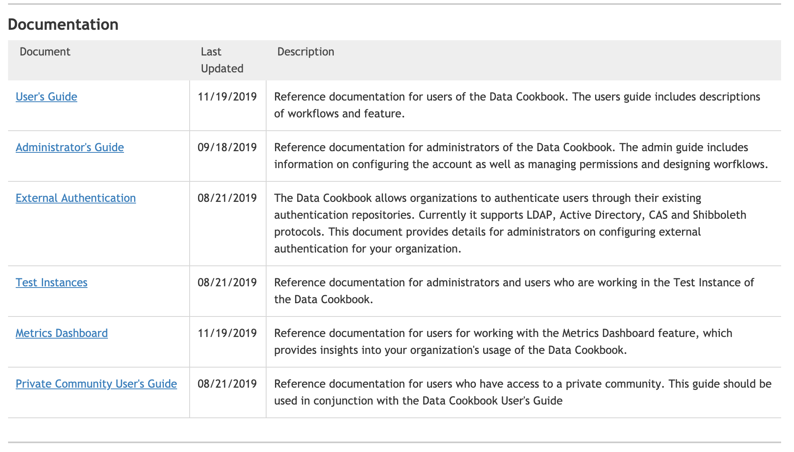
Documentation

Slide 24
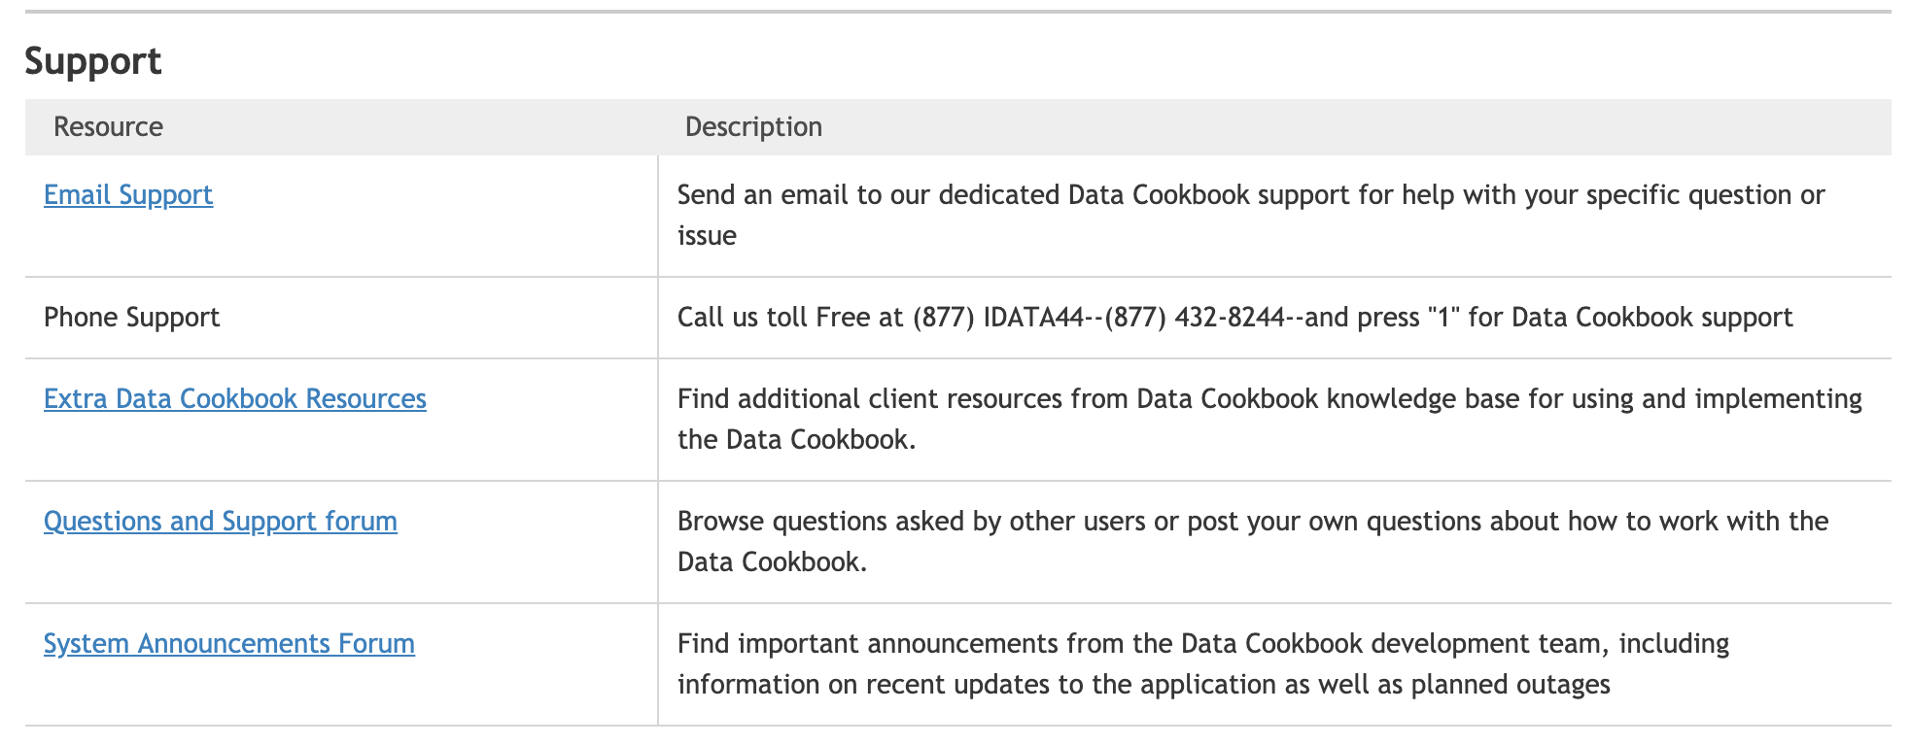
Support

Slide 25
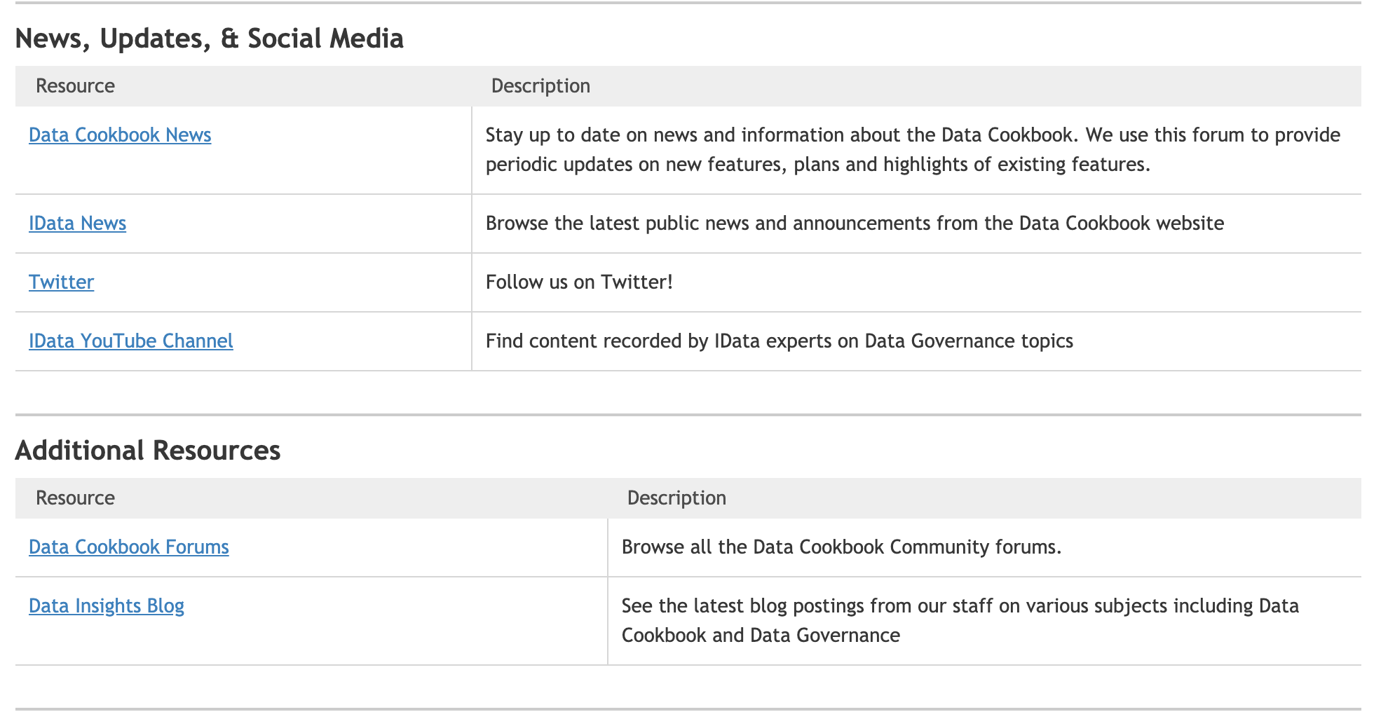
News Updates

Slide 26
Workshop Wednesday 2019-2020
Purpose: Short, fun, and focused on features
Upcoming Dates and Topics:
  Wed Dec 4 @2pm EST: Quality Rules Workflow
  Wed Jan 22 @2pm EST: Specifications 5 Ways
  Wed Feb 26 @2pm EST: How to Import Definitions
Review Previous and Upcoming Workshop Wednesdays Here:
    https://go.idatainc.com/dcb-workshops
Contact Brenda if you’d like to suggest a topic
  breeb@idatainc.com

Slide 27
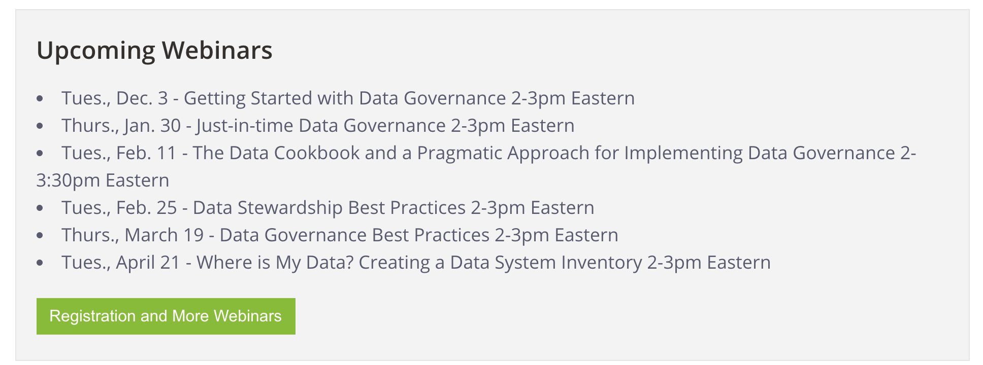
Upcoming Webinars 2019-2020
Upcoming Webinar Slide
http://www.idatainc.com/about-us/idata-webinars/
* feel free to suggest future webinar topics

Slide 28
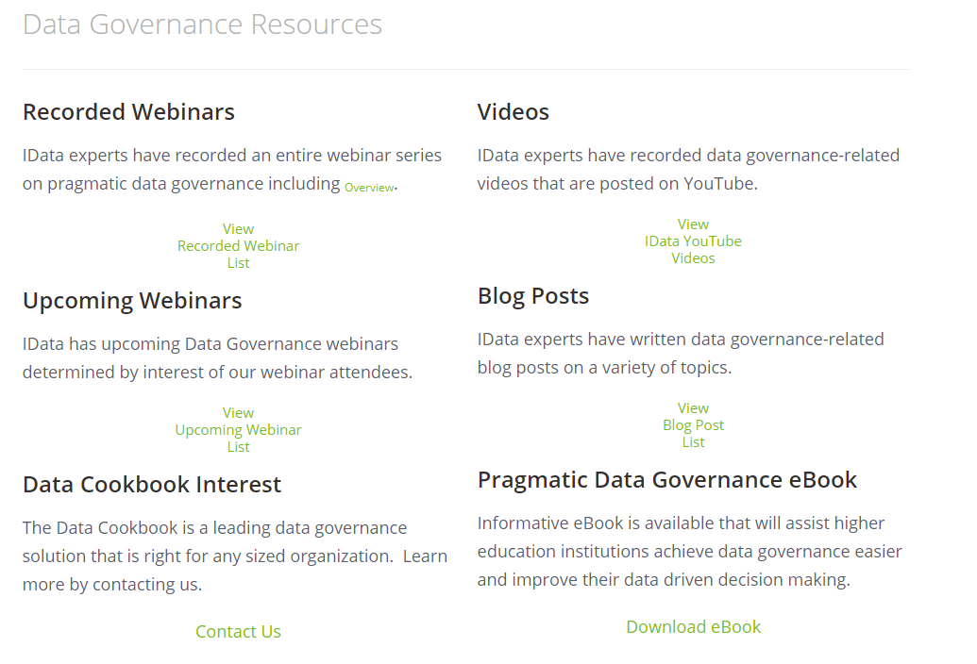
Data Governance Resources Page
http://go.idatainc.com/dg-resources

Slide 29
Get Help and Thank you!
  Pop Up Help within Data Cookbook (triangle in lower right corner)
  Ask clients – Post to Questions and Support in the Forum
  Ask IData Staff – support@datacookbook.com
  Visit http://support.datacookbook.com
  Visit Help link within Data Cookbook
    Administrators Guide (check for updates)
    User Guide (ditto)

Slide 30
Help Us Provide You With Information You Want
SEND US YOUR TOPIC SUGGESTIONS FOR:
YouTube Channel Videos
Blog Posts
Webinars
Workshop Wednesdays
Just-in-Time Trainings
Contact us at marketing@idatainc.com

Slide 31
Visit Us at Upcoming Events – Say Hi!
In 2020
  Ellucian Live (Orlando) – April
  HEDW (Ogden, UT) - April
  EDUCAUSE (Boston) – October
  More to be added to the calendar

Slide 32




Be Social
Follow us on LinkedIn for company and product information
www.linkedin.com/company/idata-incorporated
Follow Us on Twitter for to the minute information
@idatainc and @datacookbook
Subscribe to YouTube Channel for how to videos
www.youtube.com/user/DataCookbook
Subscribe to our blog posts for educational information
www.idatainc.com/insights/
Follow us, share with others and provide us with content we can tweet out
marketing@idatainc.com

Slide 33

Let Us Know
Interested in any of the following:
  Providing a testimonial quote
  Being a Data Cookbook reference
  Having a case study done about your institution
  Writing a blog post
  Co-presenting at a conference or on a webinar
Send email to marketing@idatainc.com if interested

